Slide 1


Charter City

Slide 2
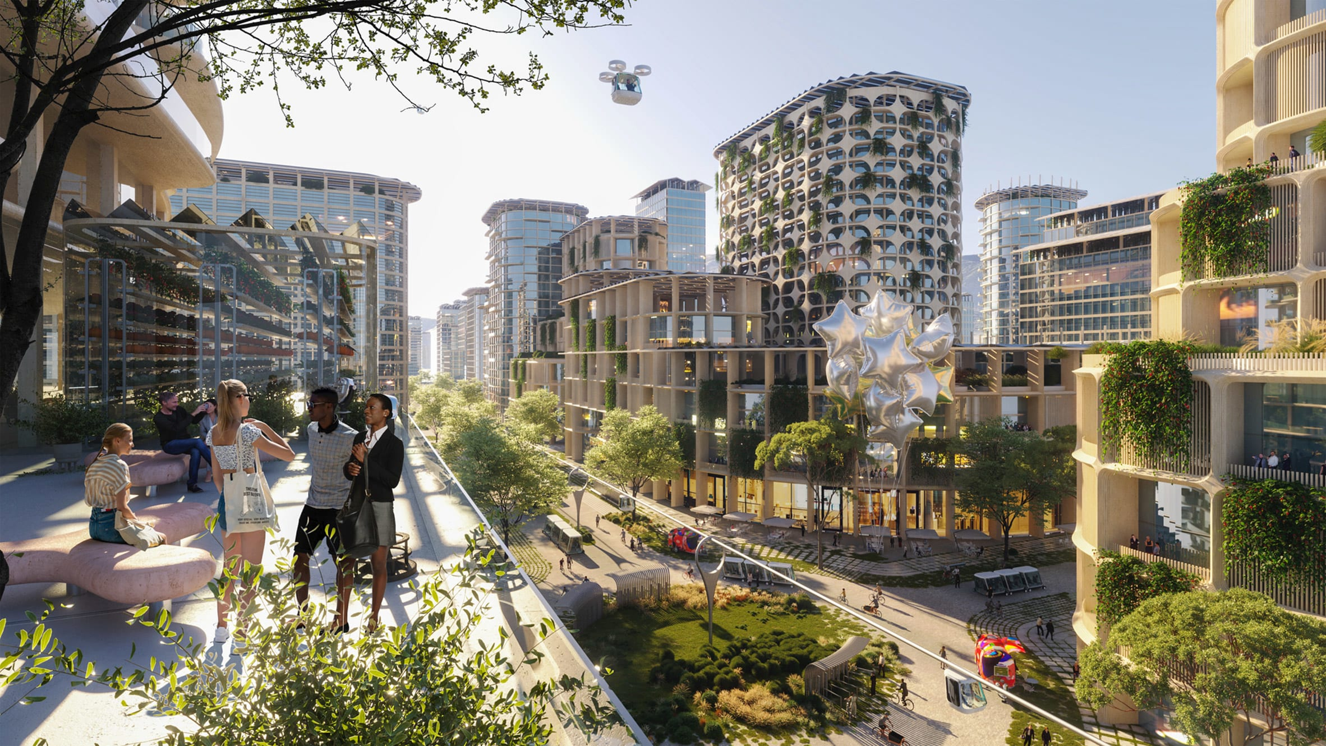


CHARTER CITIES IN CALIFORNIA
Local Control and Home Rule Authority
Constitutional Framework and Practical Considerations
Presented by Karl H. Berger

Slide 3
What is a Charter City?
A document that defines a city's powers, functions, and procedures
Comparable to the U.S. Constitution at the municipal level
Derived from California Constitution Article XI, Section 5(a)
Gives cities authority over "municipal affairs"
Charter law supersedes state law on municipal affairs

Slide 4
Two Types of California Cities
General Law Cities
Bound by all state general laws; Limited to powers granted by state constitution and statutes; Subject to all California regulations
Charter Cities
Adopt local charter; plenary authority over municipal affairs; Charter law trumps conflicting state law

Slide 5
California Charter Cities Today
121 of 482 California cities are charter cities (~25%)
Examples: Los Angeles, Long Beach, San Francisco, Oakland, Berkeley
Local examples: Downey, Cerritos, Whittier, Signal Hill, Los Alamitos, Anaheim, Irvine, Newport Beach, Huntington Beach, Buena Park, Cypress, Irvine, Newport Beach, Placentia, Santa Ana, and Seal Beach
Bellflower became charter city in 2024 (Measure B: 77.7% approval)

Slide 6
Core Municipal Affairs
Charter cities have exclusive authority over four core areas:
City police force and organization
Sub-government of the city (structure, departments)
City elections and voting methods
Compensation and qualifications of city officials

Slide 7
Additional Municipal Affairs
How the city spends its tax dollars and fiscal control
Municipal contracts and vendor selection
Land use and zoning decisions (with exceptions)
Public works contracts and bidding procedures
Prevailing wage requirements (with limits)

Slide 8
Matters of Statewide Concern
Charter cities cannot override state law on these issues:
School systems and education
Traffic regulation and vehicle licensing
Ralph M. Brown Act (open meetings)
Meyers-Milias-Brown Act (labor)
California Environmental Quality Act (CEQA)
Eminent domain procedures

Slide 9
Key Litigation: Planning and Housing
City of Redondo Beach, et al., v. Rob Bonta (2024):
Five charter cities successfully challenged SB 9 (4-plex law)
Ruling: Charter cities exempt from SB 9's application
General law cities still must comply with SB 9
Demonstrates charter power over land use decisions

Slide 10
Huntington Beach: Housing Battles
2015-2019 Timeline
2015: HB prevails: exempt as charter city from affordable housing requirements
2018: Legislature responds with SB 1333 requiring charter cities comply with housing laws
2019: Governor sues HB; HB files three lawsuits against state; state prevails

Slide 11
Huntington Beach: Recent Outcomes
Voter ID Case: HB lost; electoral integrity is statewide concern
Library Materials: HB lost; book access not a municipal affair
September 2025: Court of Appeal ruled against HB on housing
HB must adopt Housing Element within 120 days
Charter city authority over housing significantly limited

Slide 12
Prevailing Wages and State Funding
Labor Code Section 1782:
Charter cities cannot restrict prevailing wages if receiving state funding
State funding includes grants, loans, tax credits, assistance
Excludes constitutional revenue (gas tax, SB1, etc.)
Impacts city infrastructure and development projects

Slide 13
Benefits of Charter Status
Greater Local Control: Determine municipal affairs independently
Vendor Selection: Choose best-qualified vendors rather than lowest bidder
Fiscal Flexibility: Control how tax dollars are spent
Land Use Authority: Set zoning and planning policies locally

Slide 14
Challenges and Concerns
Charter Inflexibility: Requires voter approval to amend
Legislative Changes: Legislature can restrict charter powers
Litigation Risk: Courts decide what qualifies as municipal affairs
Complexity: Charter must be carefully drafted to preserve authority

Slide 15
Charter Election Results (2008-2024)
Success Rate: ~56% (12 of 23 measures passed)
Passed: Palmdale (82%), Lancaster (71%), Oceanside (54%)
Passed: Bellflower 2024 (77.7%)
Failed: Hawthorne 2022 (39.8%), Saint Helena 2024 (43.8%)
Success depends on public education and voter support

Slide 16
Two Methods to Adopt a Charter
Charter Commission
Formal, time-intensive: Voter election of 15 commissioners; Several months of meetings; Brown Act compliance required
City Council Drafted
Faster, streamlined: Council drafts charter directly; Fewer formal steps; Quicker approval timeline

Slide 17
Typical Charter Language
Simple Charter Approach:
"The City may make and enforce all ordinances and regulations in respect to municipal affairs, subject only to restrictions in this charter. On other matters, the City shall be subject to general laws. City ordinances regarding municipal affairs govern over conflicting state law."

Slide 18
Charter Adoption Timeline (City Council Method)
Phase 1: Council discussion and draft preparation (3-4 months)
Phase 2: Two public hearings, 30+ days apart (2-3 months)
Phase 3: Public outreach and voter education (6-8 months)
Phase 4: Submit to Registrar 88 days before election
Phase 5: Election vote and Secretary of State filing

Slide 19
Costs of Charter Adoption
Election Costs: $8,500-$17,000 (ballot measure administration)
Legal: City Attorney preparation and analysis
Outreach Materials: Mailers, advertising, town halls (~$21,500+)
Staff Time: City Manager, Clerk, Management Analyst involvement

Slide 20
Public Outreach and Education
Community events (5+ venues)
Senior apartments and non-profit presentations
Park location community meetings
Utility billing inserts (efficient, low-cost)
Social media and digital communications
FAQ documents and clear explanations

Slide 21
Critical Discussion Points
Housing Mandates: Charter authority limited by state housing laws
State Funding Impact: Prevailing wage restrictions lose state dollars
Bidding Authority: Vendor selection flexibility vs. competition
Council Compensation: Charter determines salary structure

Slide 22
Bellflower - Development (2018–2019)
February 2019: Council forms Charter Ad Hoc Subcommittee
Members: 2 Council Members + 7 residents
July–September 2019: Four subcommittee meetings
October 2019: Recommendations presented to Council

Slide 23
Bellflower - Voter Engagement (2022)
May 2022: Council considers ballot measure
July 2022: FM3 survey shows voter support (67%)
Timing constraints prevent 2022 ballot placement
Council decides to proceed with 2024 timeline

Slide 24
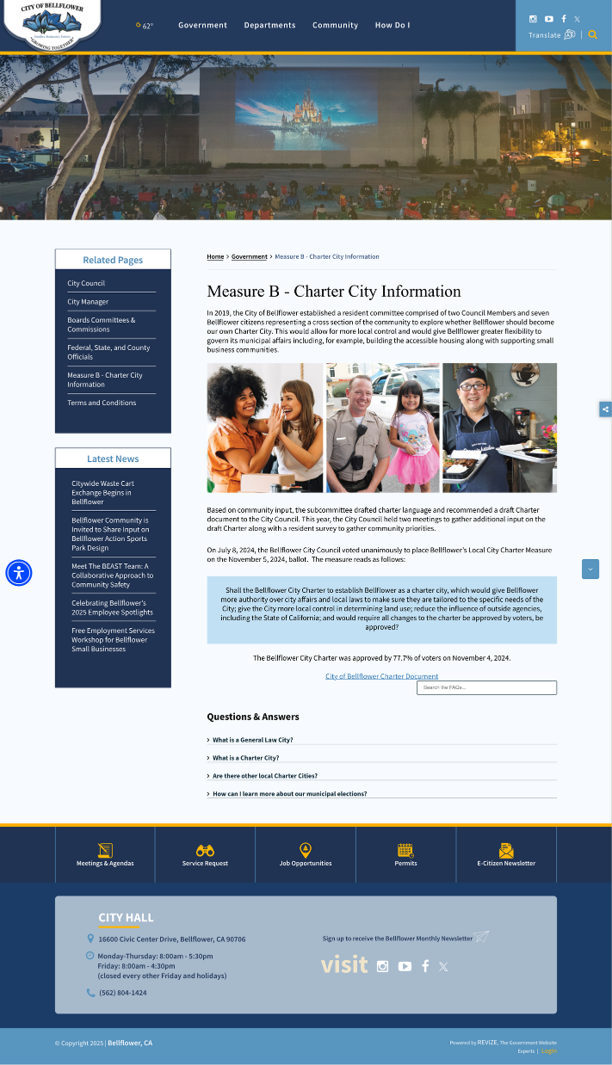
Bellflower - Public Hearings (2024)
April 8, 2024: First required public hearing
May 13, 2024: Second required public hearing
May 2024: Updated survey shows 73% support
Community outreach by City Manager and City Council Members
Postcards, surveys, and other informational materials

Slide 25
November 5, 2024: Election Day
77.7% Approval
Bellflower Charter Successfully Adopted

Slide 26
Bellflower - Preamble
Emphasizes the sovereignty of the people of Bellflower and their right to govern. Establishes that authority is delegated to local officials to act in the public interest.

Slide 27
Article I: Municipal Affairs
The City of Bellflower has the authority to make and enforce laws concerning its municipal affairs, as outlined in the Charter and the California Constitution.

Slide 28
Article II: General Laws & Council Authority
Power to adopt and enforce legislation
Charter provisions take precedence over conflicting state laws
Anti-discrimination requirement
Protect economic opportunities and housing

Slide 29
Article III: Governance & Elections
City Council: 5 elected members
Restrictions on holding multiple city offices
Compensation determined by California law
Council appoints key city officers
District boundaries subject to census review

Slide 30
Article IV: Revenue
Authority to establish revenue regulations
Management of public financing and franchises
Fiscal responsibility with reserve requirements
Flexibility for fiscal emergencies

Slide 31
Article V: Intergovernmental Immunity
City revenues cannot be taken by other governmental entities. State and federal mandates must provide compensation to the City.

Slide 32
Article VI: Public Works Projects
City Council regulates public works contracts
Emphasis on competitive bidding and best value
Authority to set wage criteria
Project labor agreements with prevailing wages

Slide 33
Article VII: Interpretation & Amendments
Charter broadly construed to facilitate municipal powers
Council implements via ordinances or resolutions
Continuity with existing laws maintained
Amendments require voter approval

Slide 34
Fountain Valley - Initial Discussion & Study
May 23, 2024: Strategic Planning Session – Charter possibility presented as potential six-month objective; no support
March 27, 2025: Strategic Planning Session – Charter study approved as six-month objective; City Attorney directed to present to Council
May 6, 2025: Council Meeting – City Attorney presented Study Session on charter cities; Council requested additional information
August 19, 2025: Council Meeting – City Attorney presented further Study Session; Council decided to hold two public Town Halls

Slide 35
Fountain Valley - Public Engagement & Decision
September 30, 2025: First Town Hall – Held at Council Chambers to gather public input
October 18, 2025: Second Town Hall – Held at Recreation Center (Saturday) to reach broader audience
November 4, 2025: Council Meeting – Presented decision on placing charter measure on ballot; Council majority voted to move forward with Council-drafted charter measure for November 2026 ballot
January 20, 2026: Presentation tonight to discuss charter measure materials, scheduling, and next steps

Slide 36
Key Legal Requirements
21-day posting period before public hearings
Publication in newspaper for two successive weeks (GC §6066)
At least 30 days between first and second public hearings
21-day wait period after second hearing before council vote
FPPC approval of outreach materials and communication plan

Slide 37
Costs to Date
Item | Amount
Attorney to the City | $11,114.70
Translation Services | $2,011.69
Staff Time (Clerk, Manager, Analyst) | $1,860.12
Total Expended | $14,985.51

Slide 38
2026 Outreach Strategy
Mailers: InfoSend citywide or utility billing
Media: Fountain Valley Living Magazine & OC Register
Events: 5 city events, senior apartments, nonprofits, parks
Languages: Spanish & Vietnamese interpreters available

Slide 39
Projected 2026 Costs
Category | Amount
Mailers (InfoSend or Utility Bill) | $16,431
Magazine & Publications | $19,688
Outreach & Staff (5 events) | $21,569
Subtotal Hard & Soft Costs | $57,688

Slide 40
Next Steps: January – February
Jan 20
Admin Item to discuss charter, communications plan, and outreach materials
Jan 21
Send Outreach Materials and Communication Plan to FPPC for Approval
Mar 17
Notice of First Public Hearing by Posting (21 calendar days prior)
Mar 23–Apr 6
Notice of First Public Hearing by Publication (14 days, per GC §6066)

Slide 41
Next Steps: March – April
Apr 7
First Public Hearing on charter proposal and content
Apr 25
Notice of Second Public Hearing by Posting (21 calendar days prior)
May 2–15
Notice of Second Public Hearing by Publication (14 days, per GC §6066)

Slide 42
Next Steps: May – June
May 16
Second Public Hearing on charter proposal (30+ days after first hearing)
Jun 11
Brown Act Agenda: Notice Resolutions Calling Election and adopting Resolution placing charter measure on November 2026 ballot (21-day wait after second hearing)
Jun 16
Resolutions Calling Election and adopting resolution placing charter measure on ballot (Second June meeting)

Slide 43
Charter Cities: A Path to Local Control
Balanced against state regulatory requirements and litigation risks
Success requires informed voters, careful drafting, and realistic expectations

Slide 44
Operational Costs
General Law vs. Charter City

Slide 45
Direction / Action
Language of the Proposed Charter
Designate OC Register for Publication of Notices
Communications Plan and Outreach Materials
Authorize the City Manager to Engage a Survey Consultant and Outreach Consultant

Slide 46
Language of the Proposed Charter
Simple Charter
[T]he [C]ity [of Fountain Valley, governed under this charter,] … may make and enforce all ordinances and regulations in respect to municipal affairs, subject only to restrictions and limitations provided in [this] charter[,] and in respect to other matters [the City of Fountain Valley] shall be subject to general laws.
The City of Fountain Valley hereby avails itself of the full charter power provided by the California Constitution. Any city ordinance or regulation regarding a municipal affair will govern over the general law of the state.

Slide 47
Language of the Proposed Charter
Simple+ Charter (Bellflower Example
See also Council Member Bui Example)
Charter Authority
Governance and Elections
Revenue
Intergovernmental Immunity
Public Works

Slide 48
Language of the Proposed Charter
Complex Charter
Lengthy Charter
Covers Many Areas of Governance Structure
Risky Because Once Approved, Revisions Require Voter Approval

Slide 49
Designate Newspaper for Notice Publication
“Notice of the public hearings shall be given by publication … in a newspaper designated by the governing body and circulated throughout the city”[.] (Gov. Code 34458(b).)
The Orange County Register is a newspaper circulated throughout the City.
Staff Recommends Council “designate” the Orange County Register as the newspaper for publication of public hearing notices.

Slide 50
Communications Plan
Proposed Future Outreach-Communications Plan and Outreach Materials
Mailers: InfoSend citywide or utility billing
Media: Fountain Valley Living Magazine & OC Register
City events (6 events)
    Summerfest (6/18 and 6/19)
    Concerts in the park (2) – 7/9 and 7/16
    Great FV Campout (8/2)
    Movie in the Park (8/14)
Senior apartments, nonprofits, parks (12-15)
Languages: Spanish & Vietnamese interpreters available

Slide 51
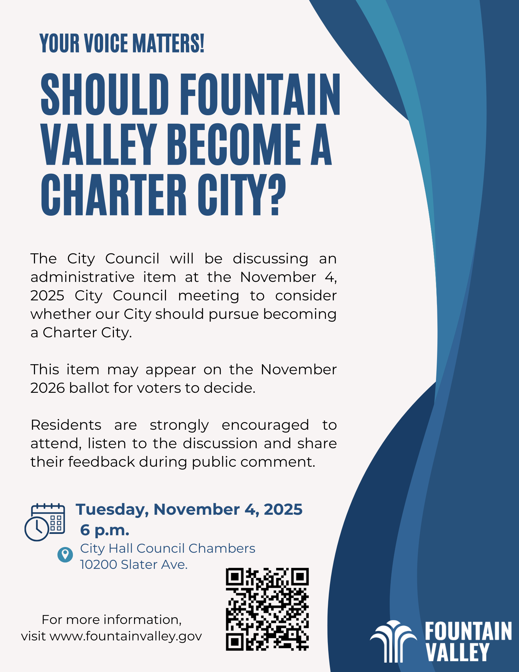
Outreach Materials

Slide 52
Survey and Outreach Consultants
FM3 Survey
Contact 400 residents
Margin of error 5%
15–20-minute survey
Languages | Survey Length
 | 15 minutes | 20 minutes
English, Spanish and Vietnamese by phone; English online | $31,500 | $35,000
English, Spanish and Vietnamese by phone and online | $32,750 | $36,500

